Slide 1







DRUG MANAGEMENT SYSTEM
Ushasini
Janagama
Abhishek
Patil
Chaitanya
Koribilli
Aniruddha
Chitte
Arjun
Kavungal
DAMG6210 - Data Management and Database Design
Under the guidance of Prof. Manuel D Montrond

Slide 2




OVERVIEW
The database is designed to help pharmaceutical companies manage drug data by streamlining case management related to adverse effects, drug interactions, patient history, and product-specific information
PURPOSE
Ensure accurate adverse drug reaction (ADR) reporting.
Facilitate compliance with FDA, MHRA, and other regulatory standards.
Enhance drug safety and decision-making processes through efficient data management.

Slide 3





OBJECTIVES
#1
Case Management: Manage adverse event cases efficiently across drugs, devices, and
patients
# 2
#5
#3
#4
Regulatory Reporting: Facilitate standardized reporting of adverse event cases to
regulatory bodies
Streamlined Communication: Enable better communication between manufacturers,
healthcare providers, and regulatory bodies
Data Integration: Integrate data from various sources such as clinical trials, patient
history, and product development reports
Decision Support: Provide data analytics and reporting features to assist pharmaceutical
companies in making informed decisions regarding drug safety

Slide 4
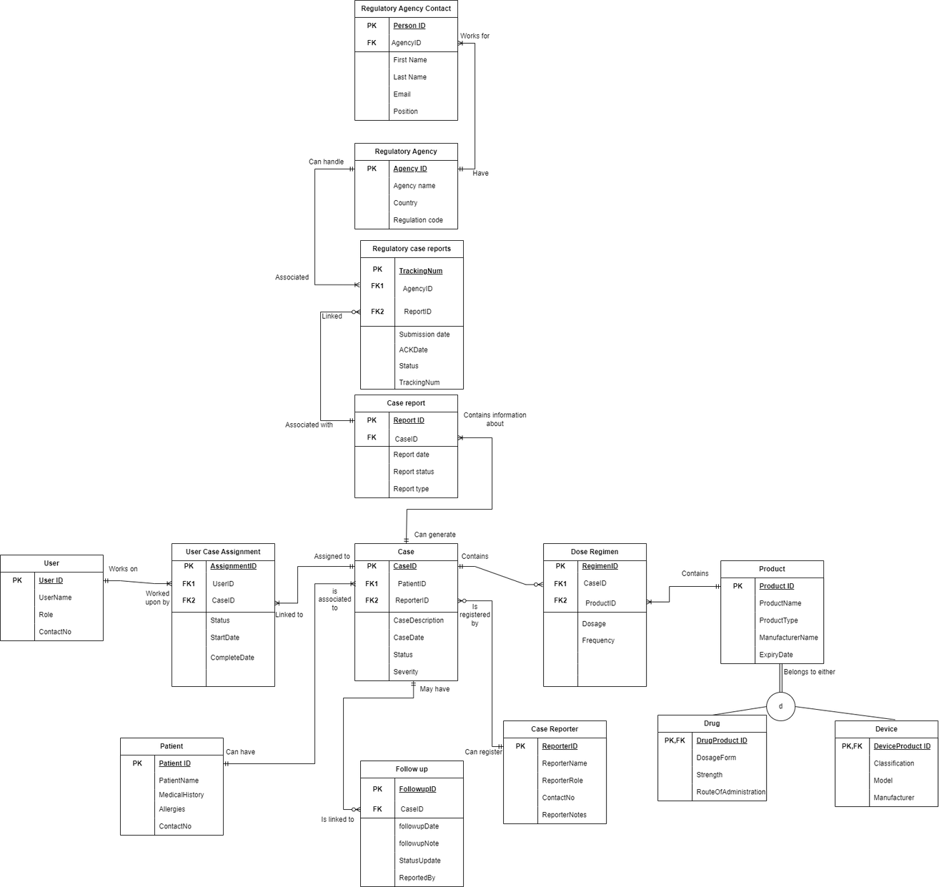
LOGICAL ERD

Slide 5

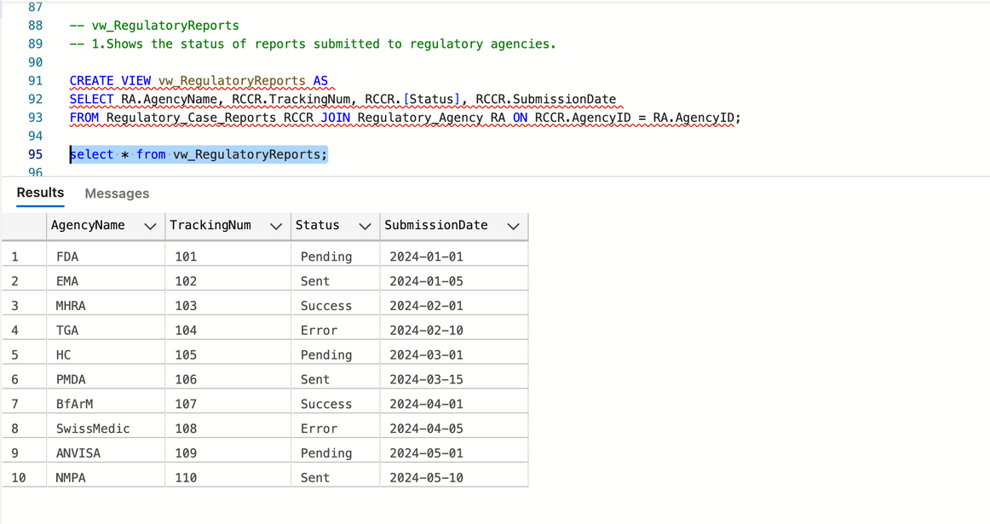
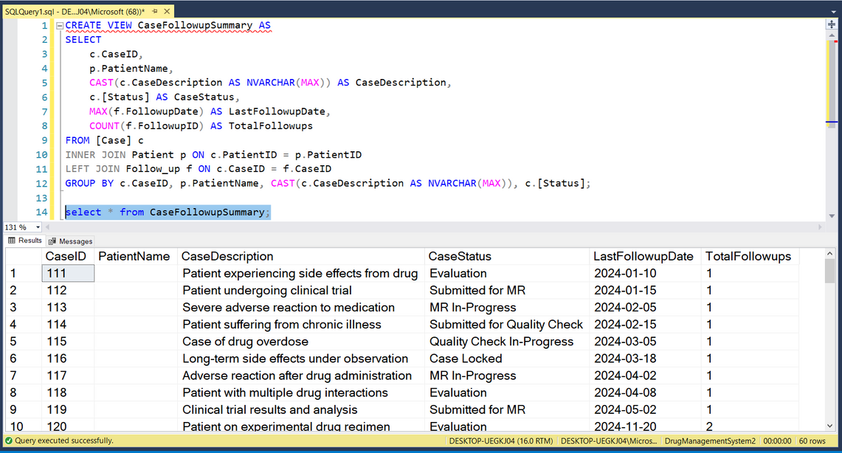
VIEWS
vw_RegulatoryReports
CaseFollowupSummary
Purpose: This view displays the status of regulatory reports submitted to regulatory agencies, showing the tracking number, submission date, and current status.
Use in Decision Making: Regulatory Compliance: Organizations can use this view to monitor the status of reports submitted to regulatory bodies, ensuring that all required reports are filed and are up to date. If there are delays or issues, corrective actions can be taken to ensure compliance.
Purpose: This view provides insights into cases, their current status, the patient involved, the most recent follow-up date, and the total number of follow-ups.
provides insights into cases, their current status, the patient involved, the most recent follow-up date, and the total number of follow-ups

Slide 6
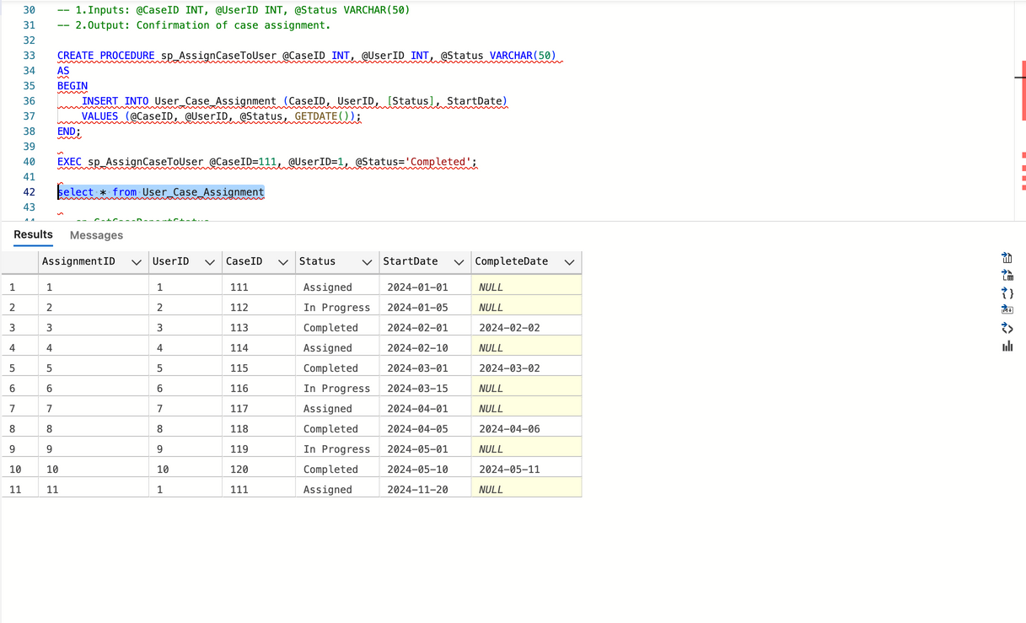
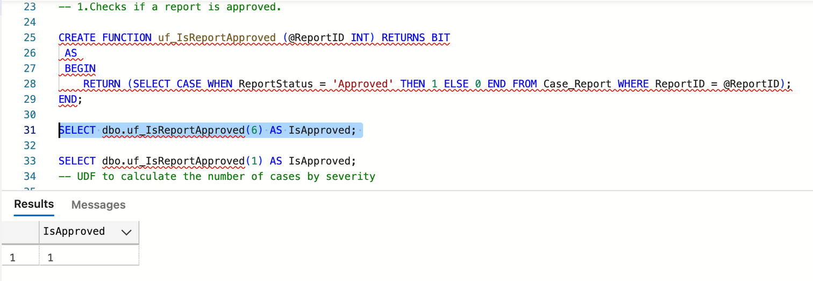
Procedures
User Defined Functions
CREATE TRIGGER UpdateCaseStatusOnFollowup
ON Follow_up
AFTER INSERT
AS
BEGIN
UPDATE [Case]
SET [Status] = 'Evaluation'
FROM [Case]
INNER JOIN Inserted i ON [Case].CaseID = i.CaseID;
END;
Triggers

Slide 7
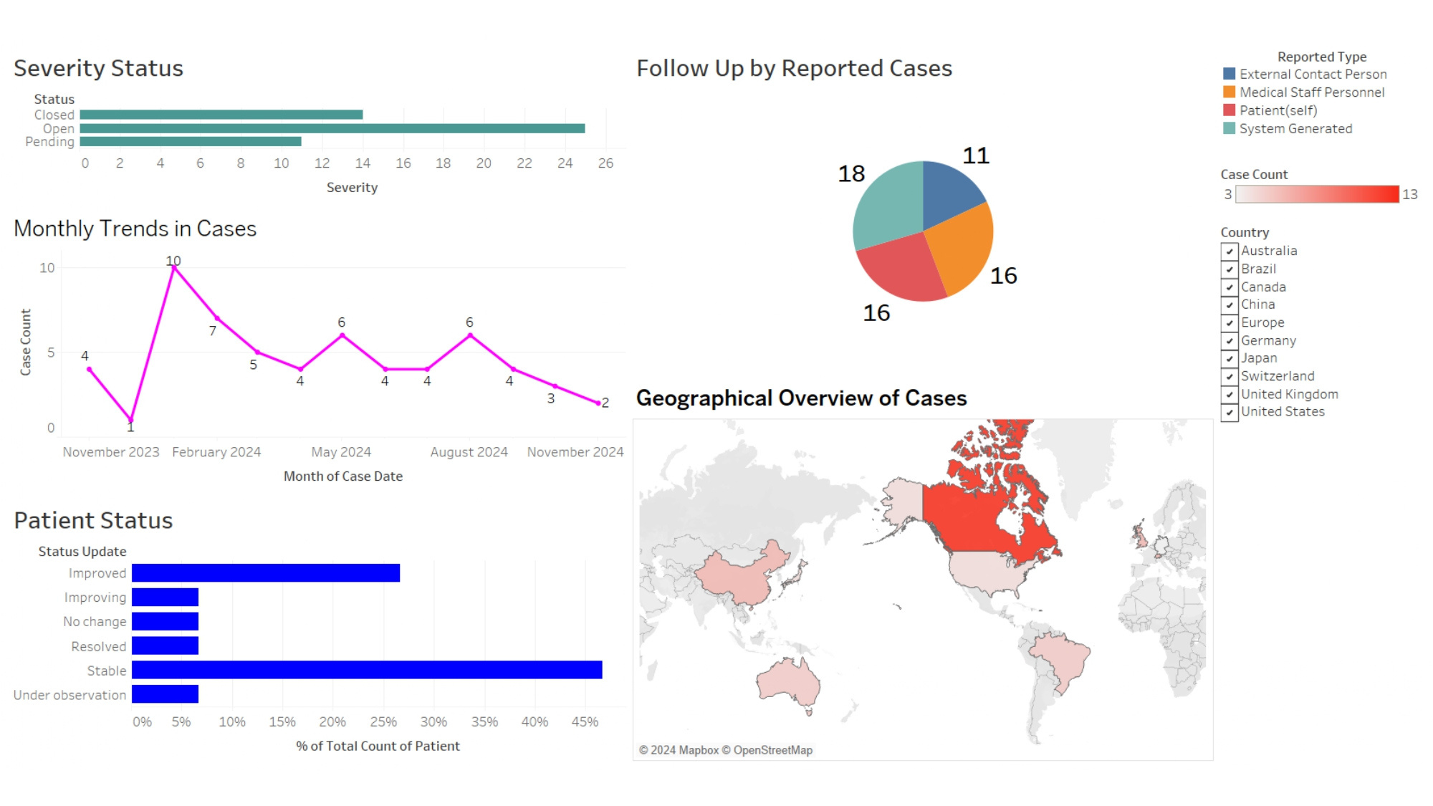
DATA VISUALIZATION

Slide 8



